Slide 1
Driver
/*SET PACKAGES*/
/* IMPORT LIBRARIES*/
/*Driver Class*/
/* MapReduce program*/
Public class #name_of_driver extends Configured implements Tool{
@Override
public int run(String[] args) throws Exception {
Path inputPath;
Path outputDir;
int n. umberOfReducers;
int exitCode;
numberOfReducers = Integer.parseInt(args[0]);
inputPath = new Path(args[1]);
outputDir = new Path(args[2]);
//job
Configuration conf = this.getConf();
Job job = Job.getInstance(conf);
job.setJobName(”JOBNAME");
//path
FileInputFormat.addInputPath(job, inputPath);
FileOutputFormat.setOutputPath(job, outputDir);
//Format
job.setInputFormatClass(TextInputFormat.class);
job.setOutputFormatClass(TextOutputFormat.class);
//Class of Driver for this job
job.setJarByClass(#name_of_driver .class);
//Mapper Class
job.setMapperClass(MapperClassName.class);
job.setMapOutputKeyClass(OutputKeyType.class);
job.setMapOutputValueClass(OutputValueType.class);
//Reducer Class
job.setReducerClass(ReducerClassName.class);
job.setOutputKeyClass(OutputKeyType.class);
job.setOutputValueClass(OutputValueType.class);
job.setNumReduceTasks(numberOfReducers);
//Combiner
Job.setCombinerClass(CombinerName.class);
//Execute the job
if (job.waitForCompletion(true)==true)
exitCode=0;
else
exitCode=1;
return exitCode;
} //end of the run method
/*Main method of the Driver*/
public static void main(String args[]) throws Exception {
int res = ToolRunner.run(new Configuration(),
new #name_of_driver (), args);
System.exit(res);
} //end of main method
}//end if public class #name_of_driver
Data Types:
Writable
WritableComparable interface
Text
IntWritable
LongWritable
FloatWritable
InputFormat:
TextInputFormat
KeyValueTextInputFormat
SequenceFileInputFormat
OutputFormat
TextOutputFormat
SequenceFileOutputFormat

Slide 2
Mapper
Combiner
/*SET PACKAGES*/
/* IMPORT LIBRARIES*/
class MapperClassName extends Mapper<
MapperInputKeyType, // Input key type
MapperInputValueType, // Input value type
MapperOutputKeyType, // Output key type
MapperOutputValueType > {// Output value type
/*Implement Map Method*/
protected void map(
MapperInputKeyType key, // Input key type
MapperInputValueType value, // Input value type
Context context) throws IOException, InterruptedException {
// Split each sentence in words. Use whitespace(s) as delimiter
// (=a space, a tab, a line break, or a form feed)
// The split method returns an array of strings
String[] words = value.toString().split("\\s+");
// Iterate over the set of words
for(String word : words) {
// Transform word case
String cleanedWord = word.toLowerCase();
// emit the pair (word, 1)
context.write(new OutputKey,
new OutputValue);
}
}
}
/*SET PACKAGES*/
/* IMPORT LIBRARIES*/
class CombinerName extends Reducer<
MapperInputKeyType, // Input key type
MapperInputValueType, // Input value type
MapperOutputKeyType, // Output key type
MapperOutputValueType > {// Output value type
/*Implement Map Method*/
protected void Reduce(
MapperInputKeyType key, // Input key type
MapperInputValueType value, // Input value type
Iterable< ReducerInputValueType > values,
Context context) throws IOException, InterruptedException {
context.write(new OutputKey,
new OutputValue);
}
}
}

Slide 3
Reducer
/*SET PACKAGES*/
/* IMPORT LIBRARIES*/
/* Reducer Class */
class MyReducerClass extends Reducer<
ReducerInputKeyType, // Input key type
ReducerInputValueType, // Input value type
ReducerOutputKeyType, // Output key type
ReducerOutputValueType> { // Output value type
@Override
protected void reduce(
ReducerInputKeyType key, // Input key type
Iterable< ReducerInputValueType > values,
Context context) throws IOException, InterruptedException {
int occurrences = 0;
// Iterate over the set of values and sum them
for (IntWritable value : values) {
occurrences = occurrences + value.get();
}
context.write(new OutputKey, new OutputValue));
} //end of reducer Method
}//end of Class MyReducerClass

Slide 4

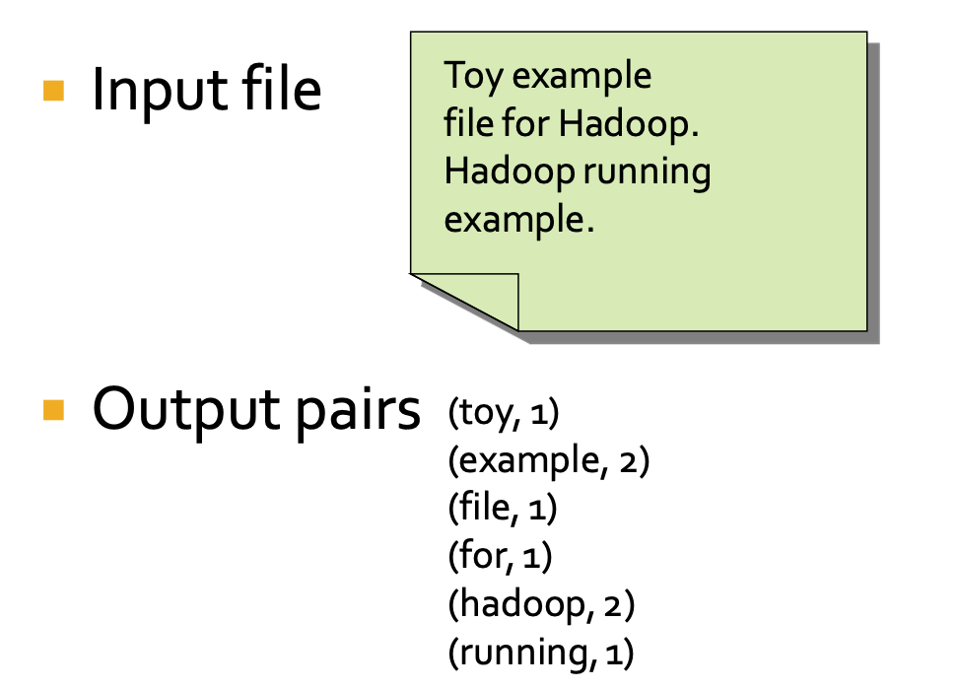
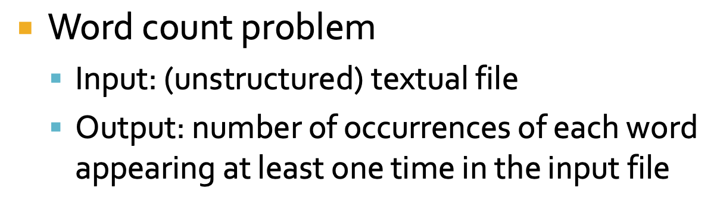
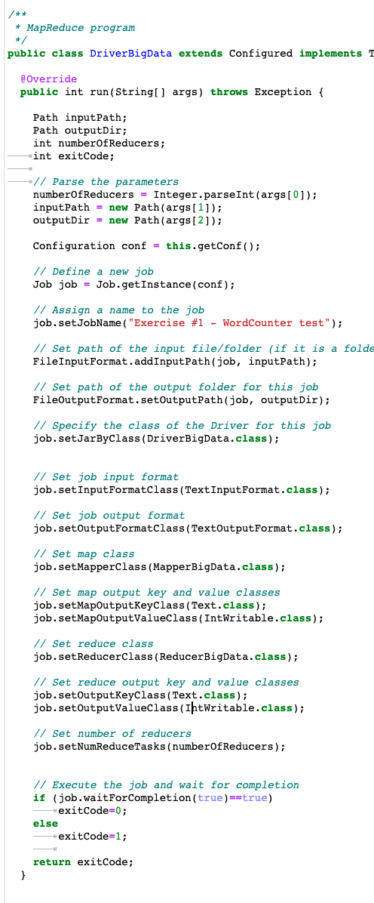
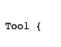
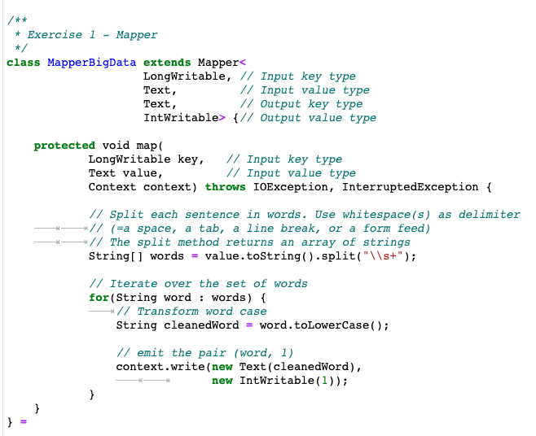
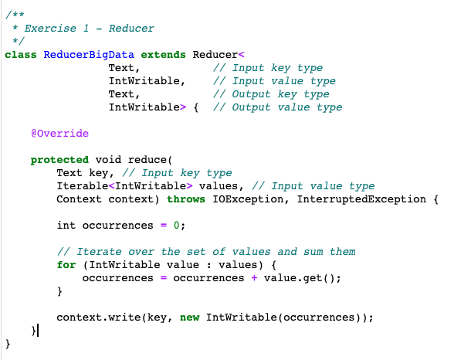
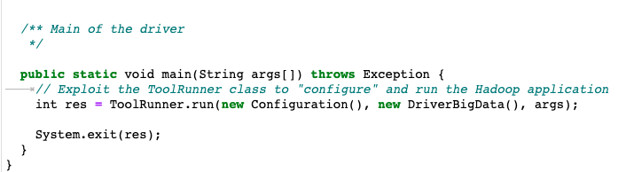

Slide 5

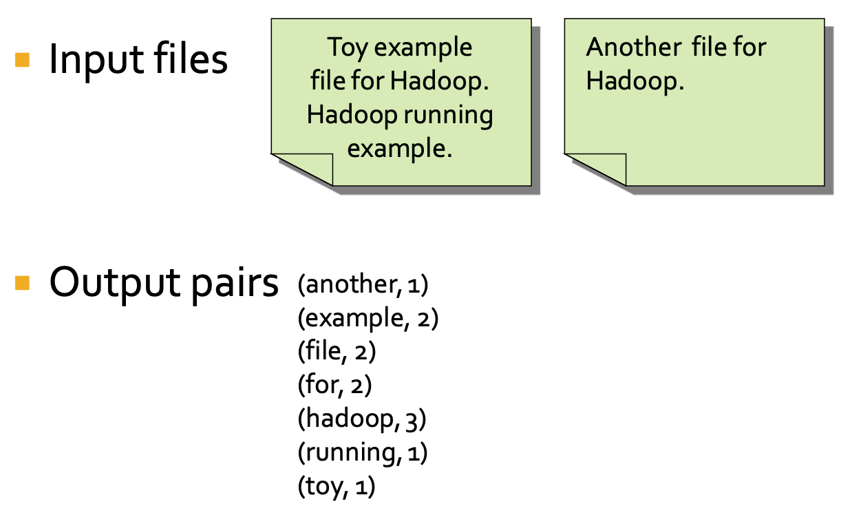
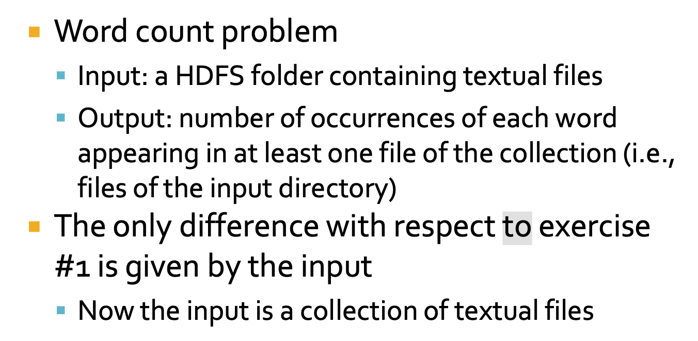
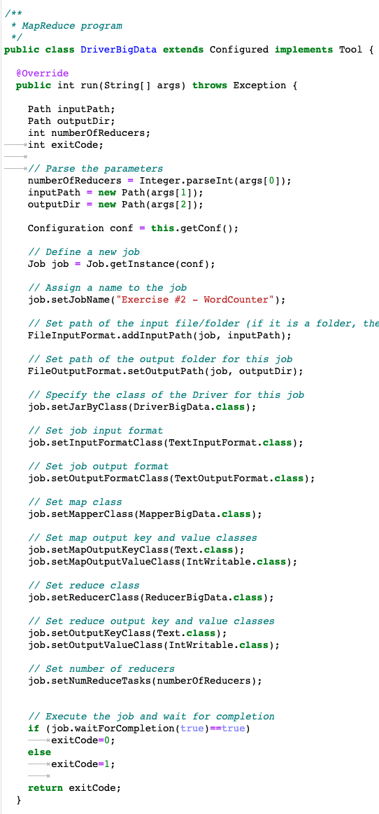
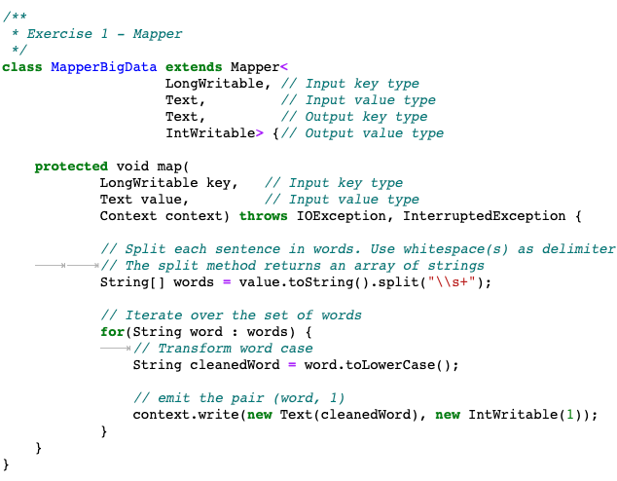
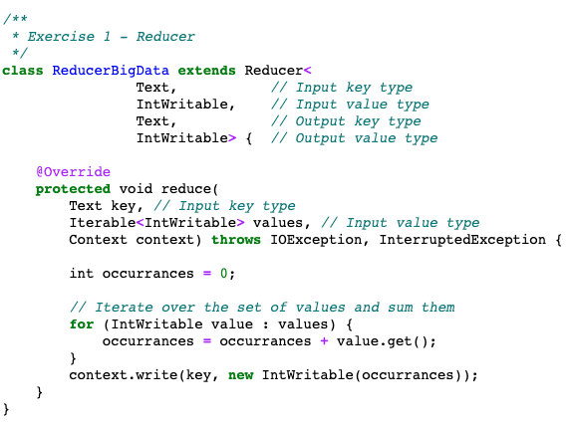
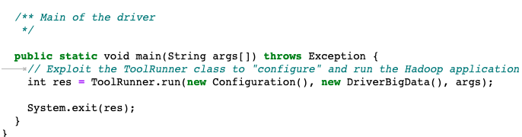
Notes:
الان از پترن multiple inputs استفاده کرده؟ اگر آره چرا توی درایورش مثلا ۲ تا input path نداده بهش؟ اگر نه، چه جوری از دو تا فایل خونده؟ به نظر میاد که یک mapper هم داریم!

Slide 6

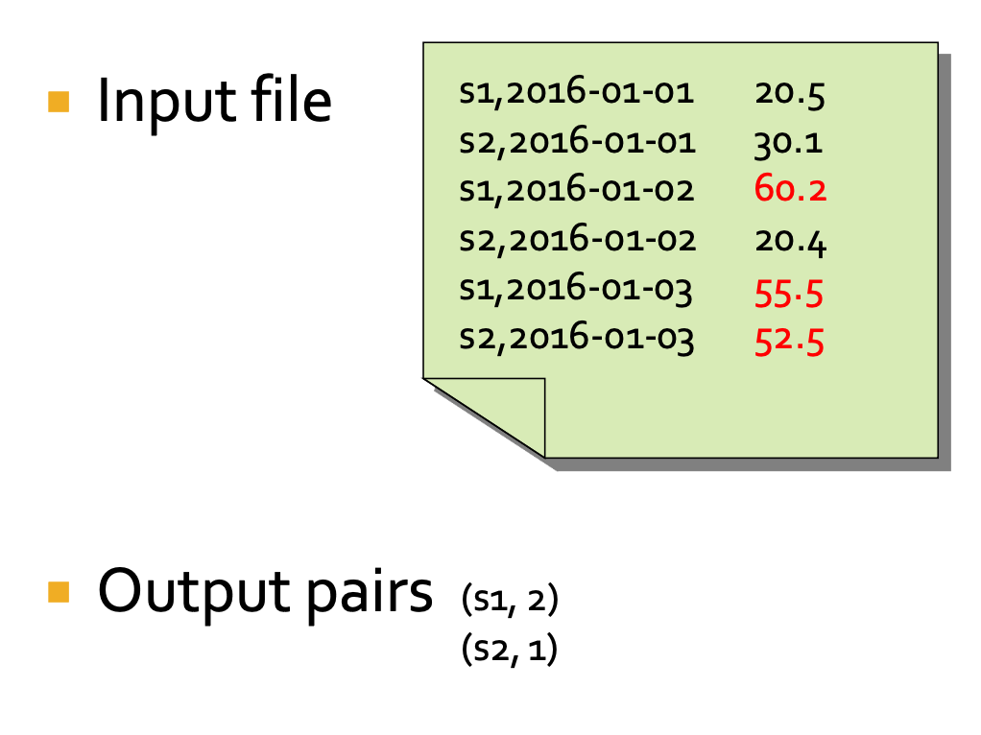
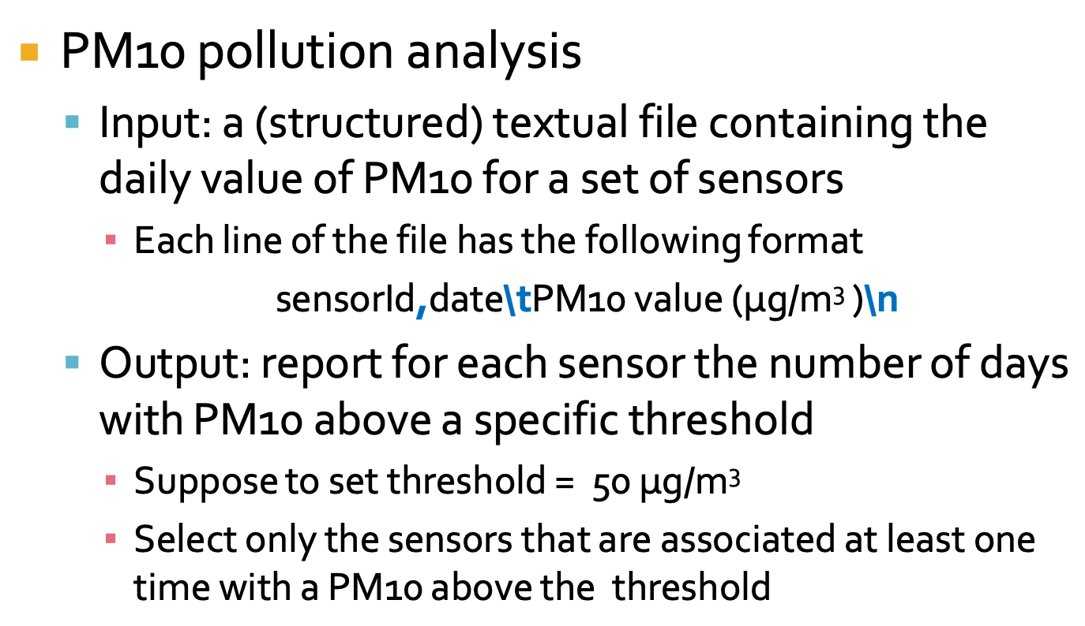
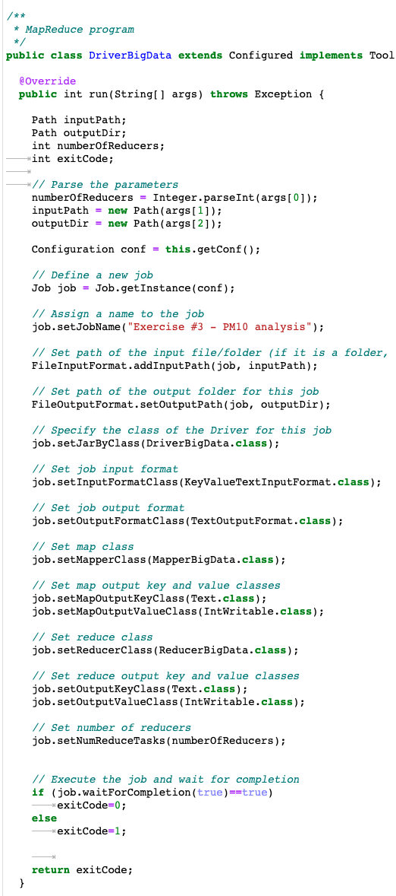
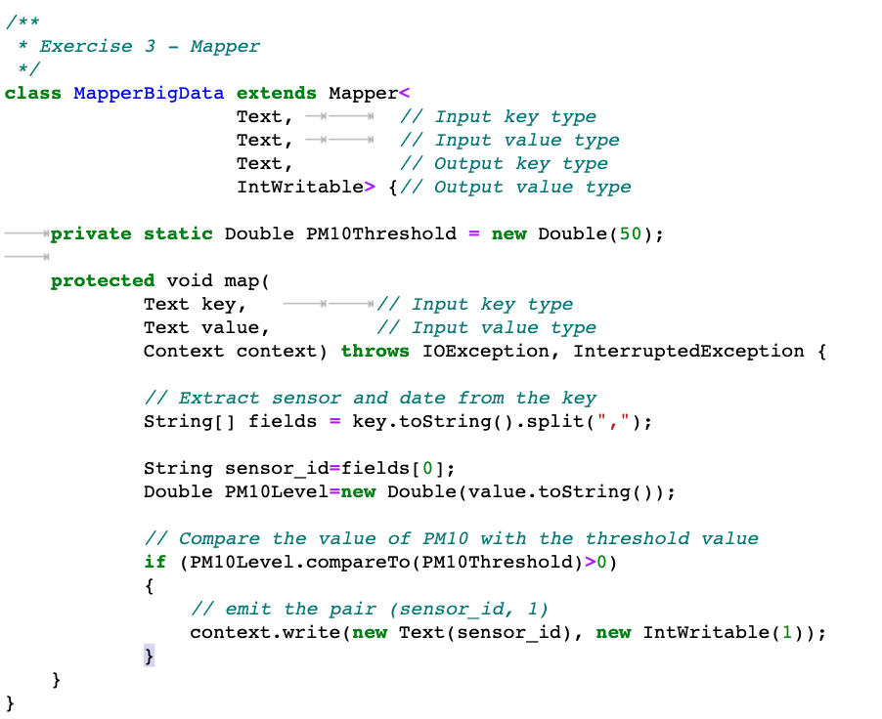
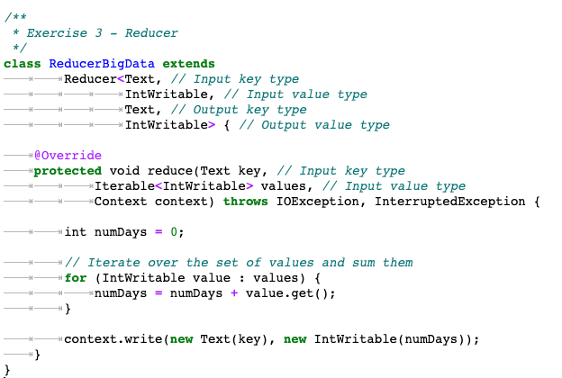
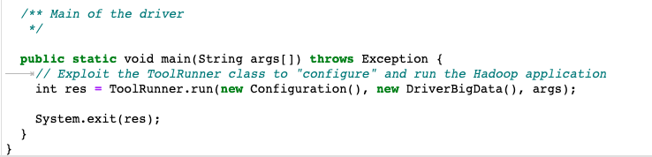

Slide 7

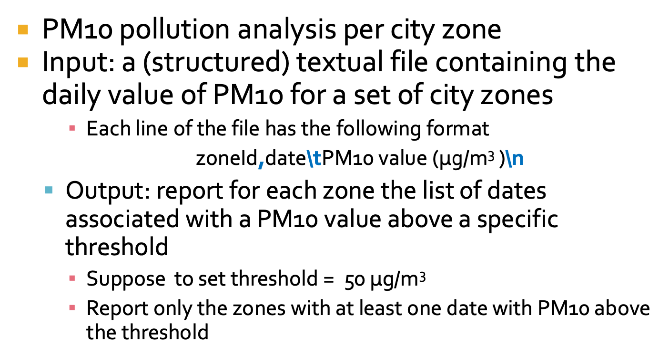
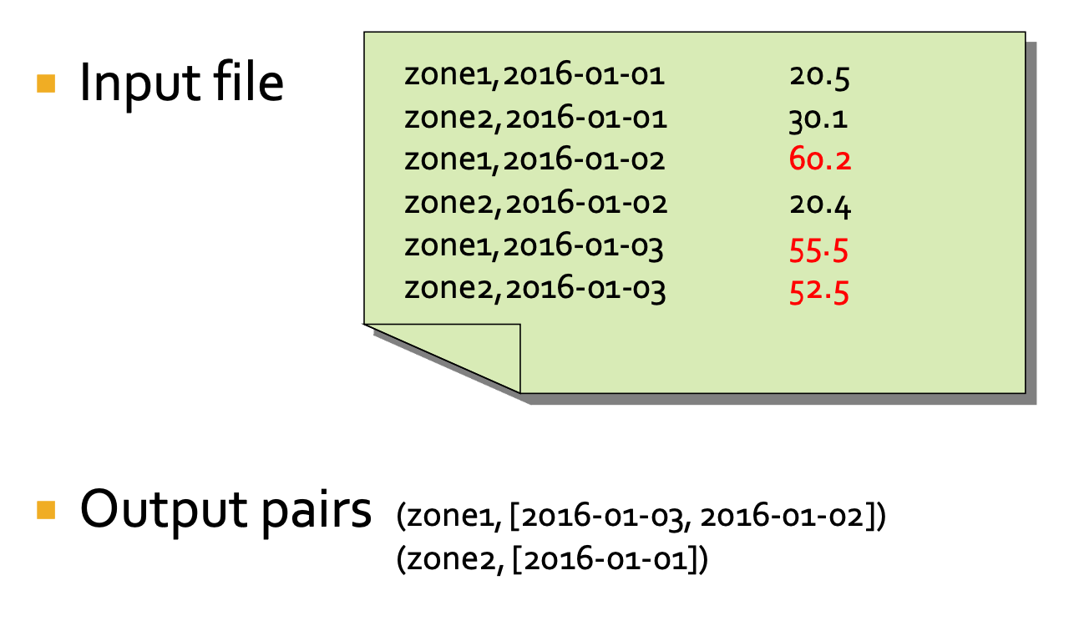
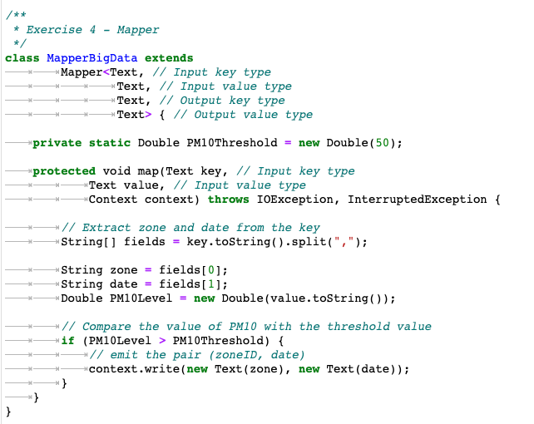
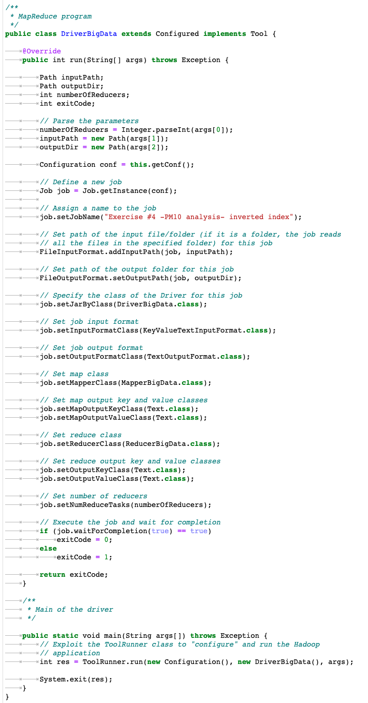
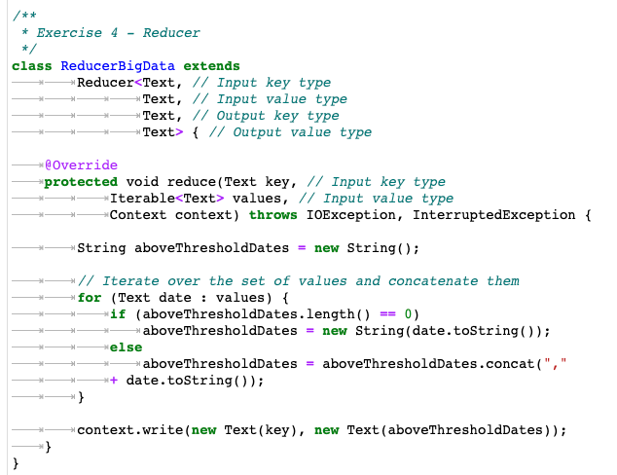

Slide 8

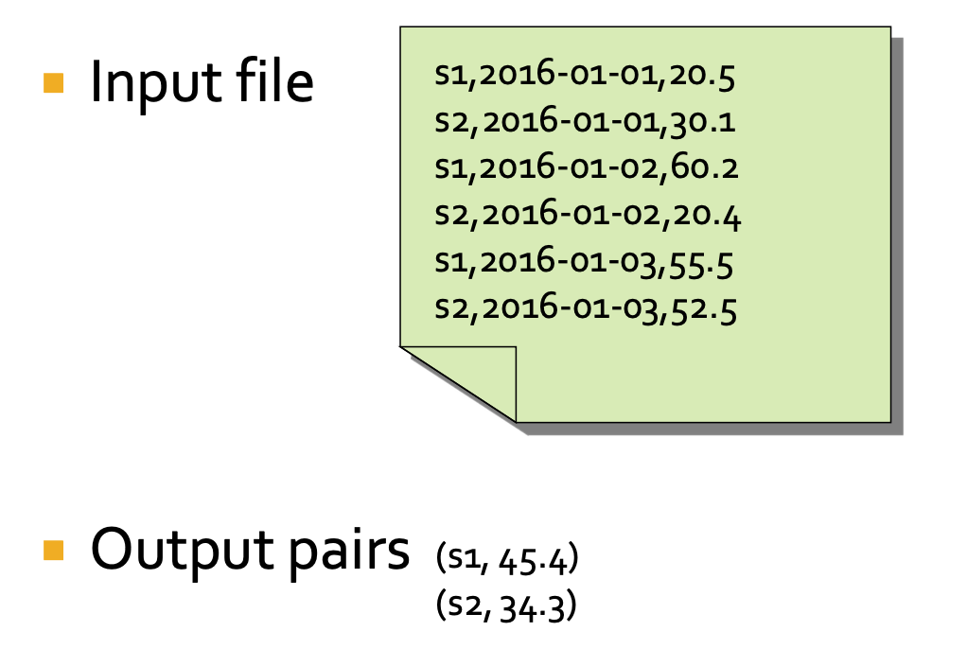
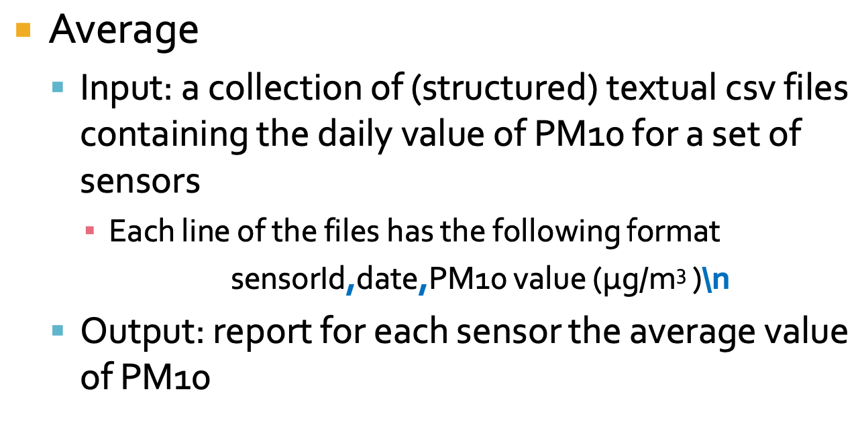
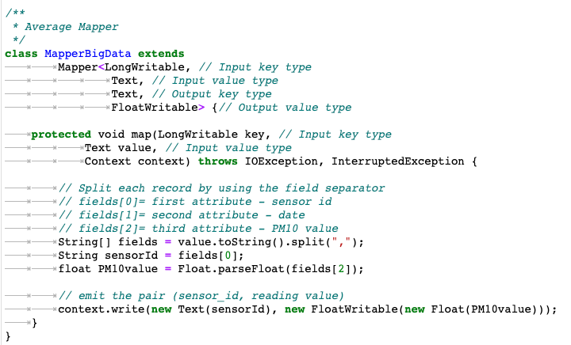
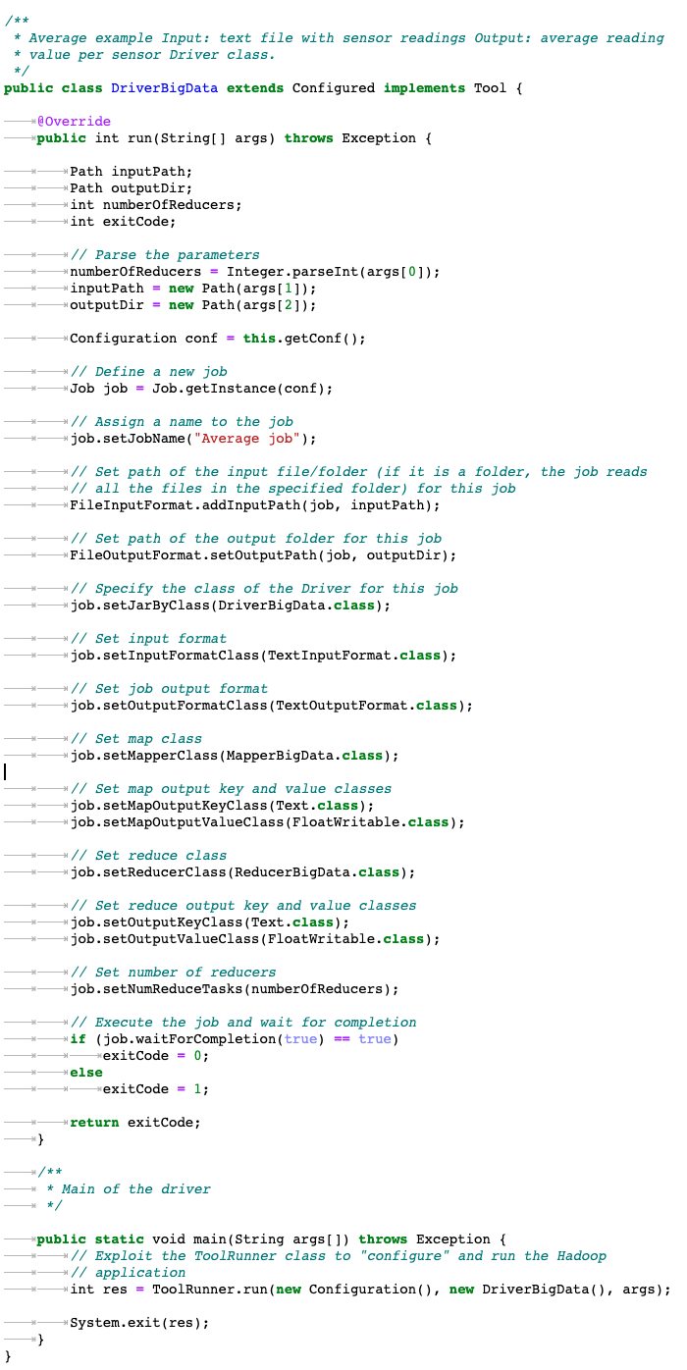
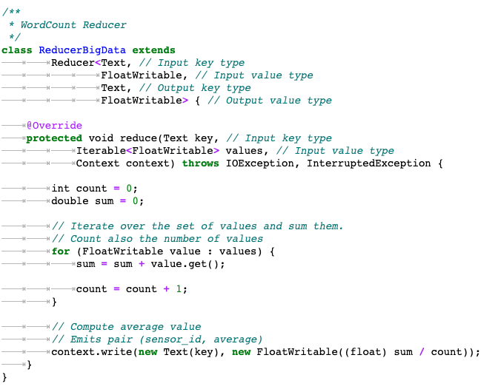

Slide 9

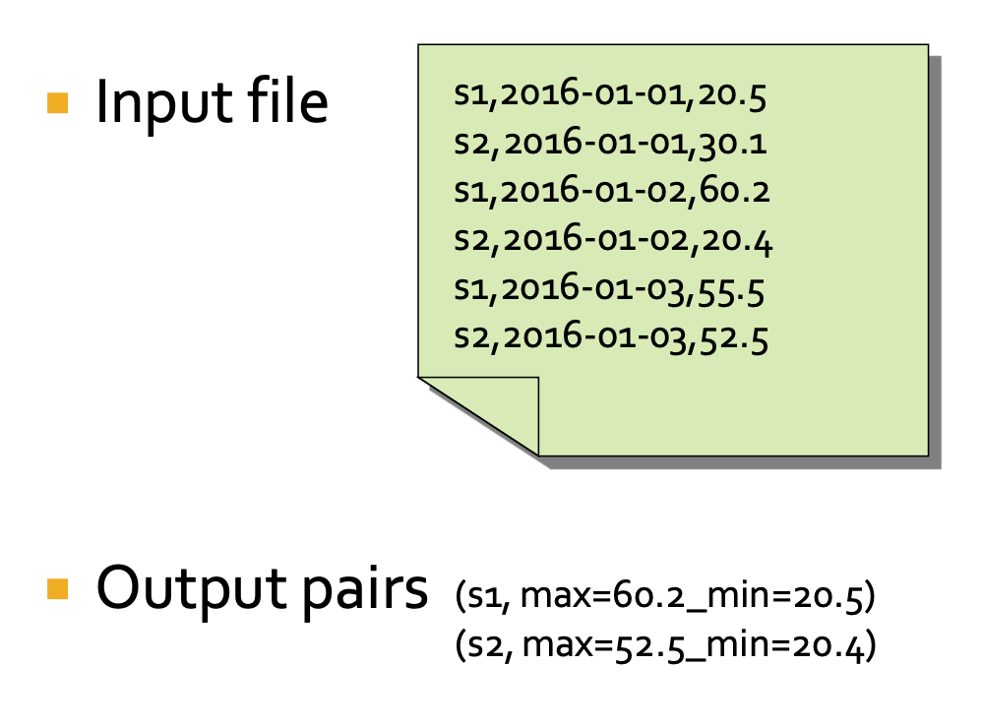
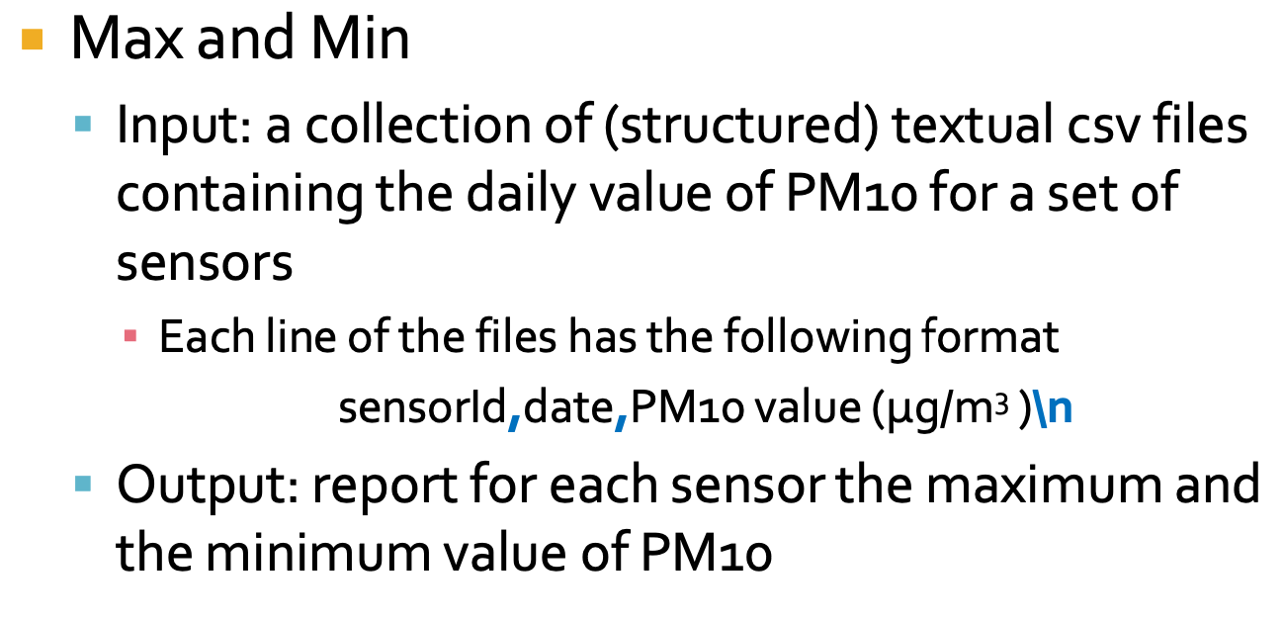
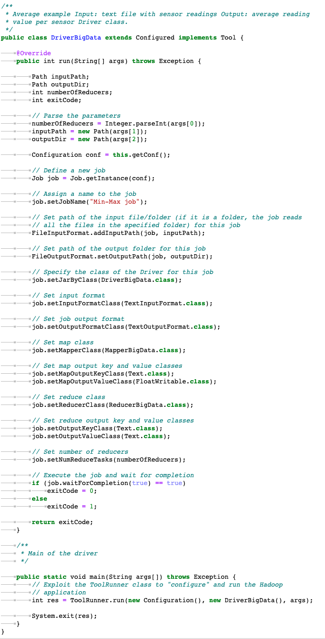
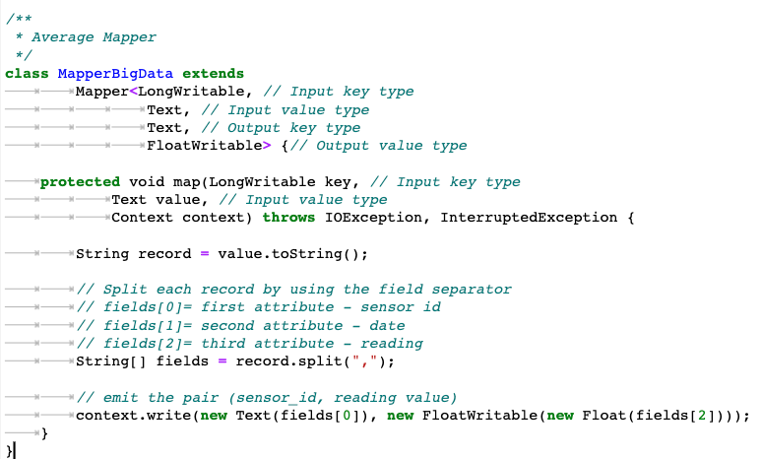
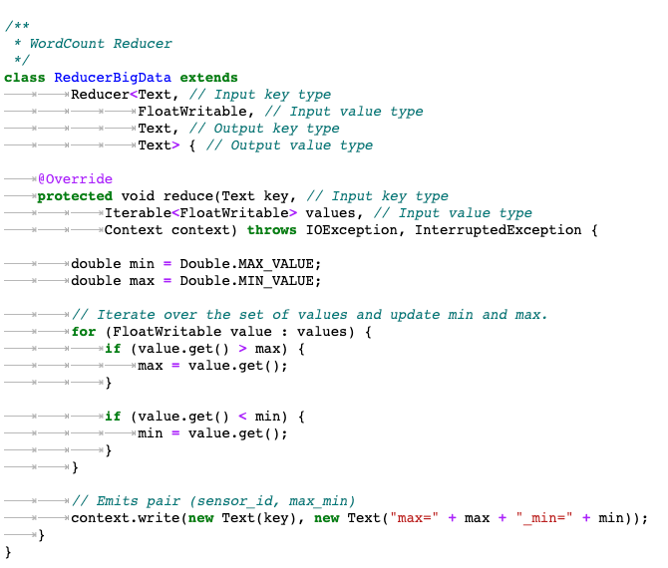

Slide 10

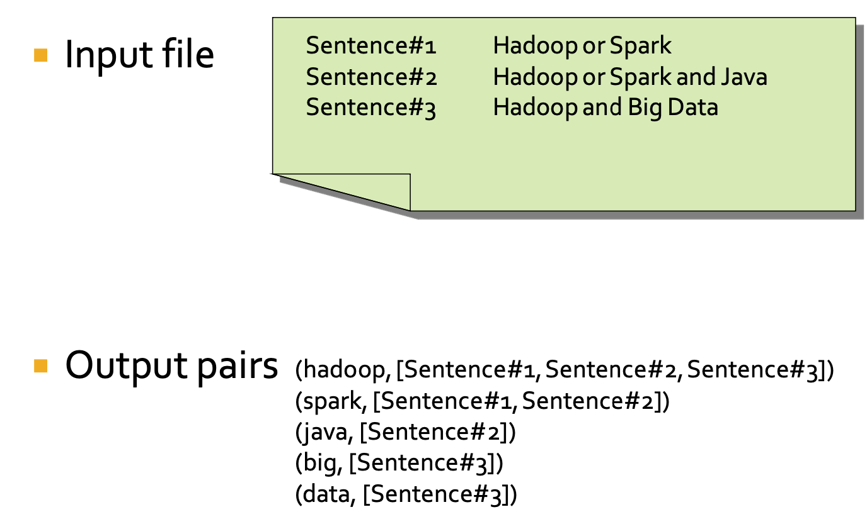
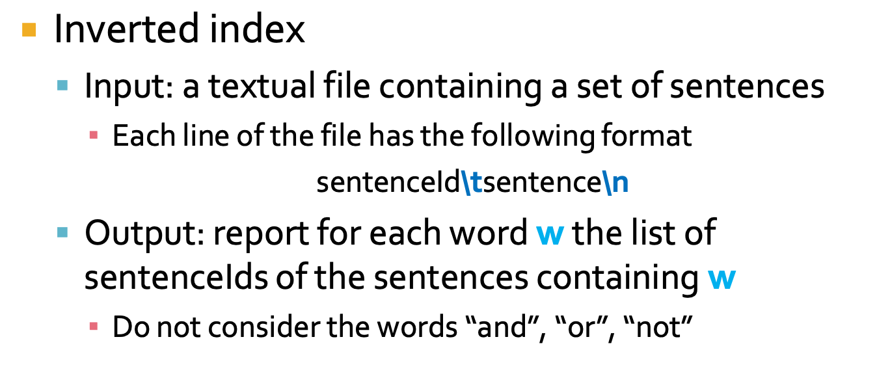
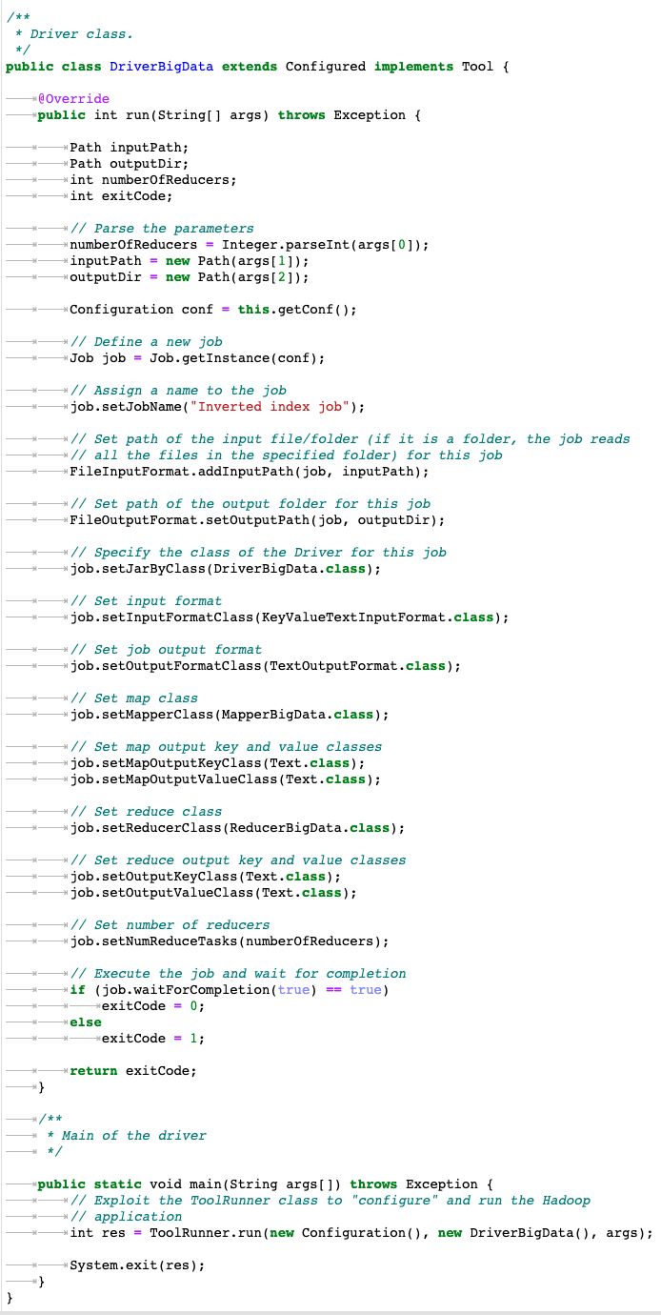
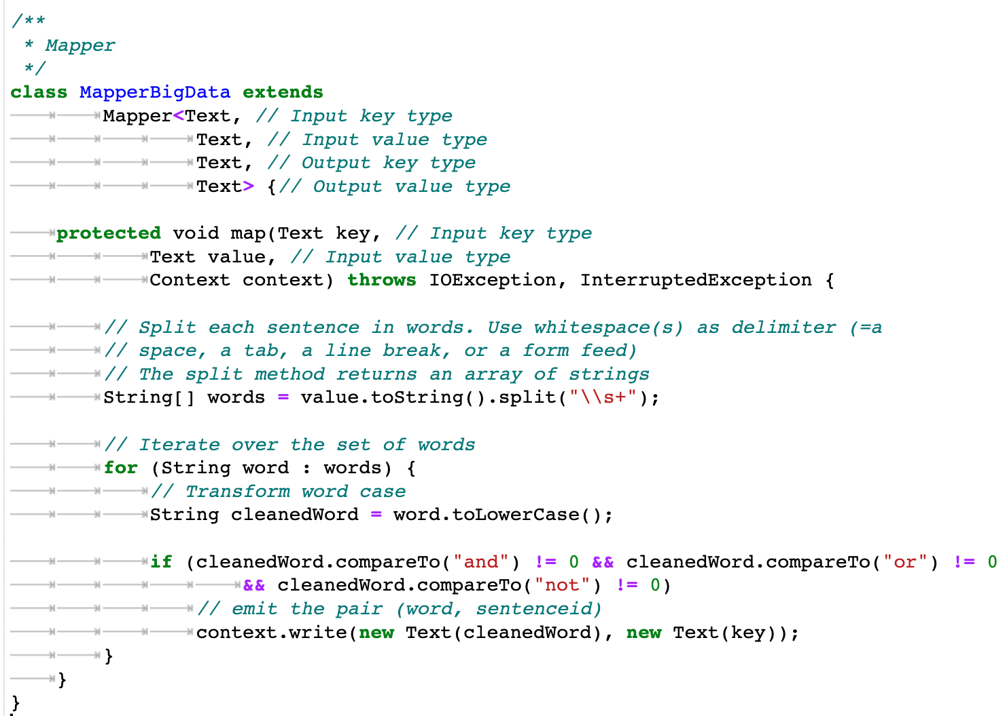
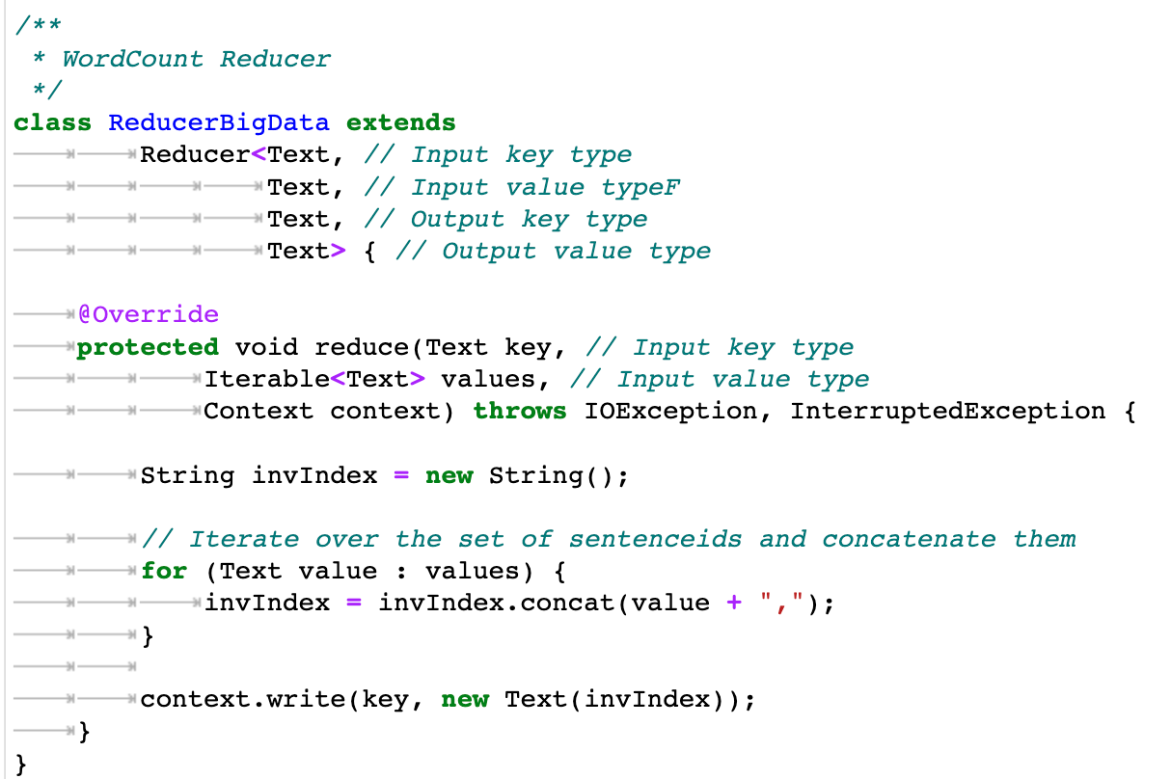

Slide 11

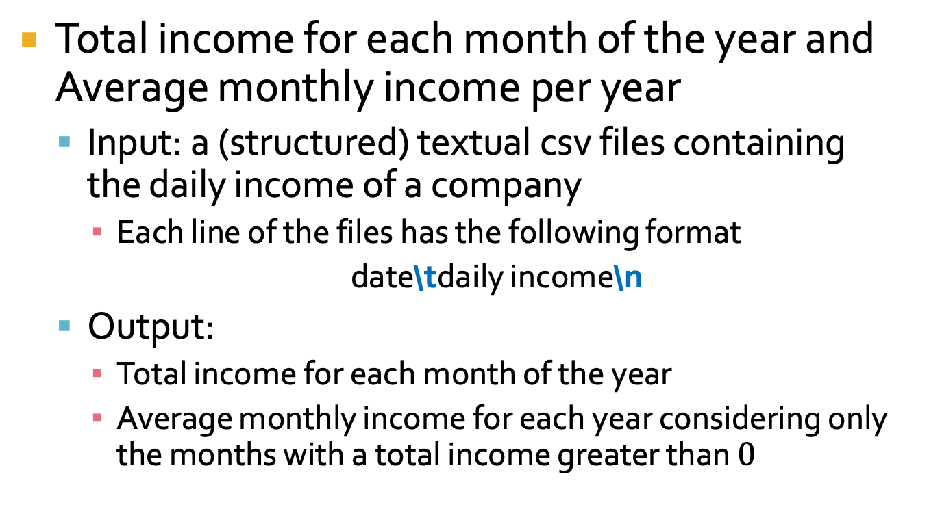
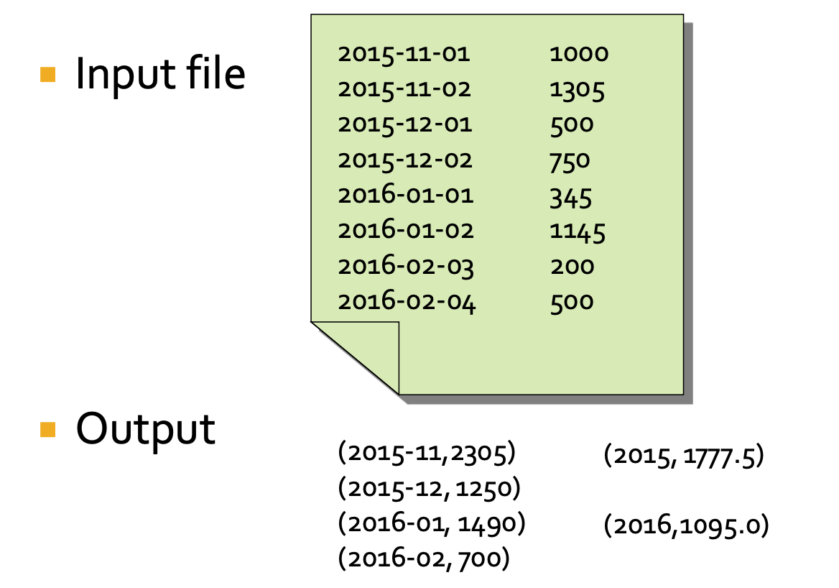
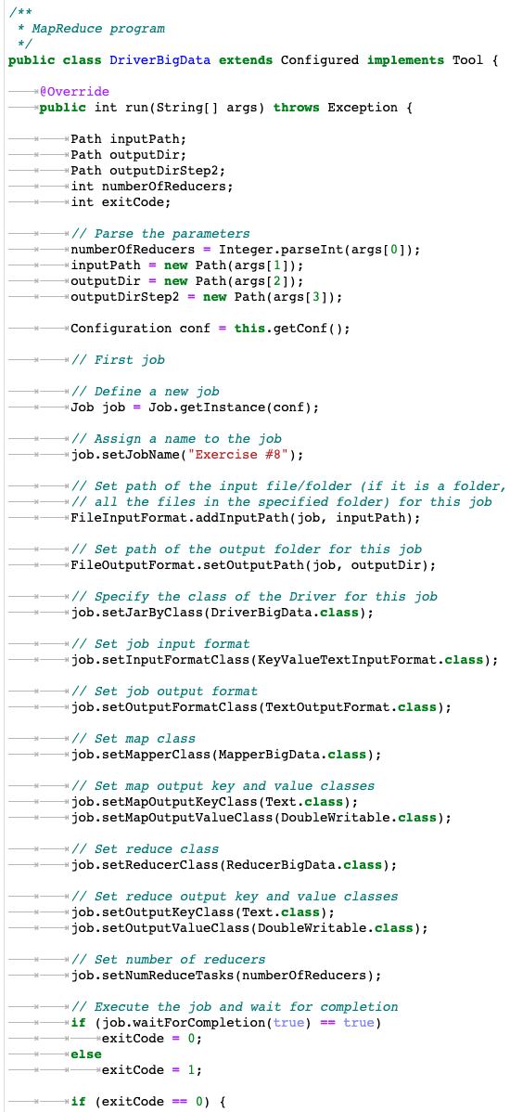
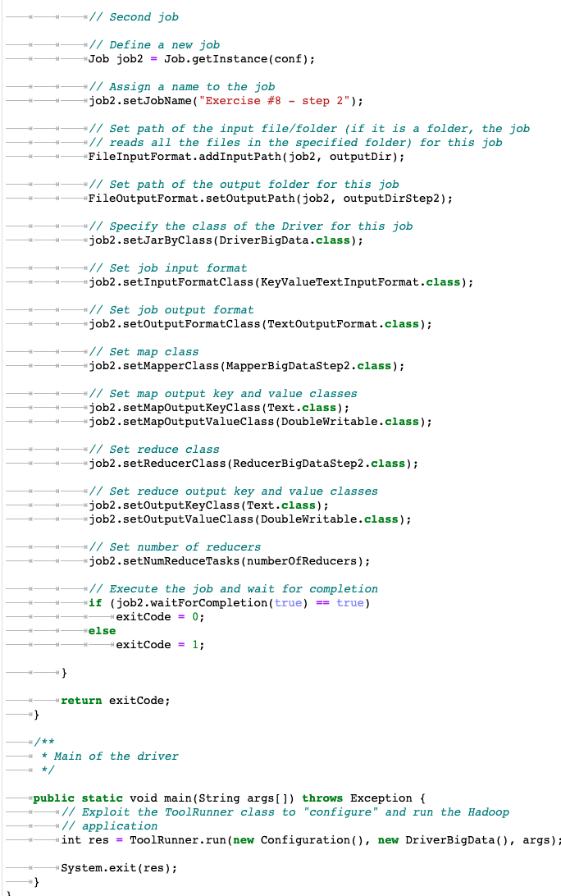

Slide 12
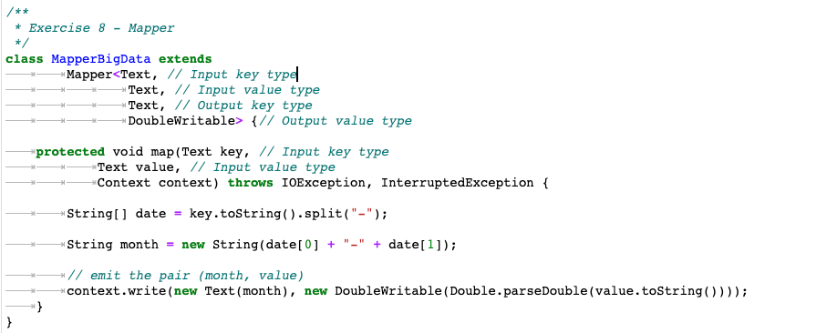
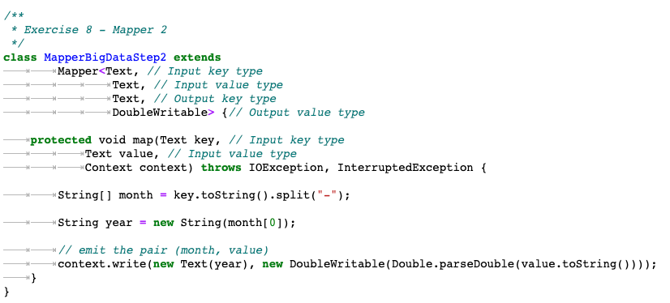
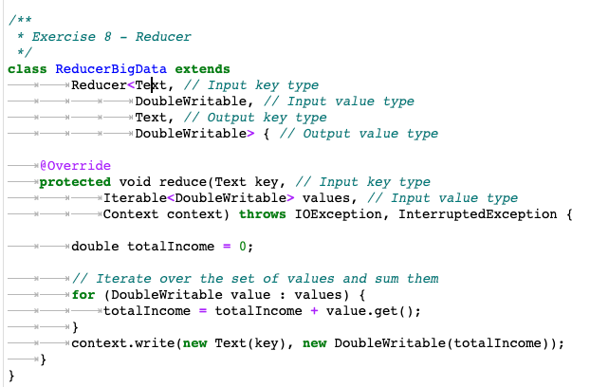
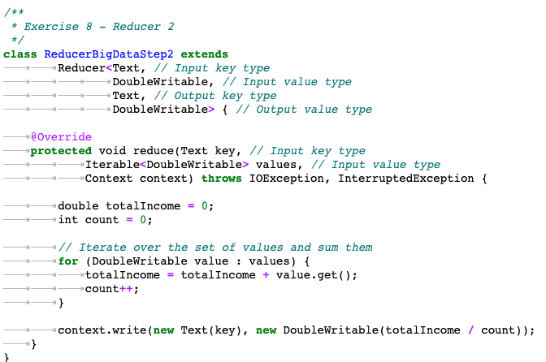

Slide 13

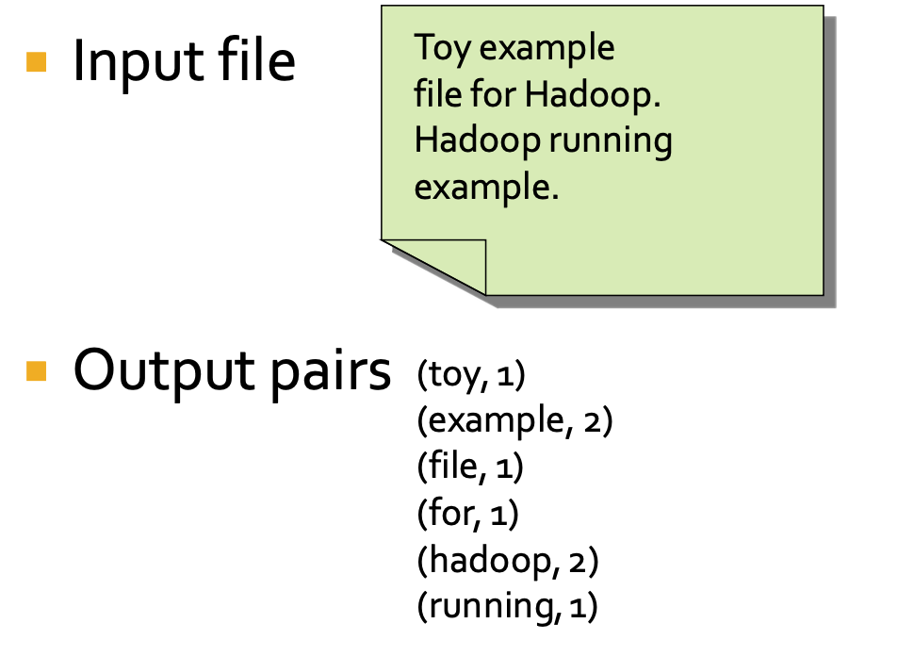
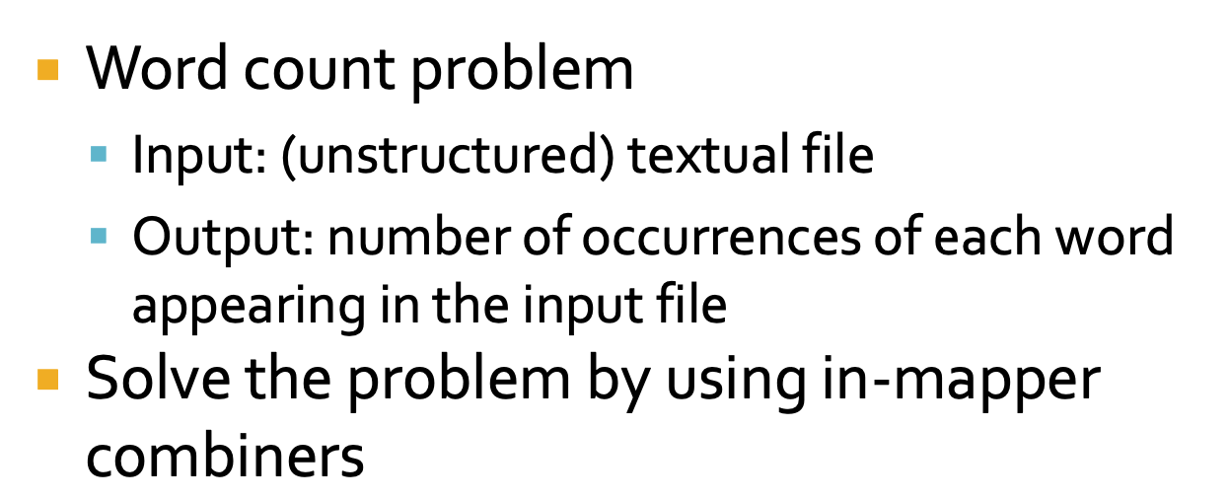
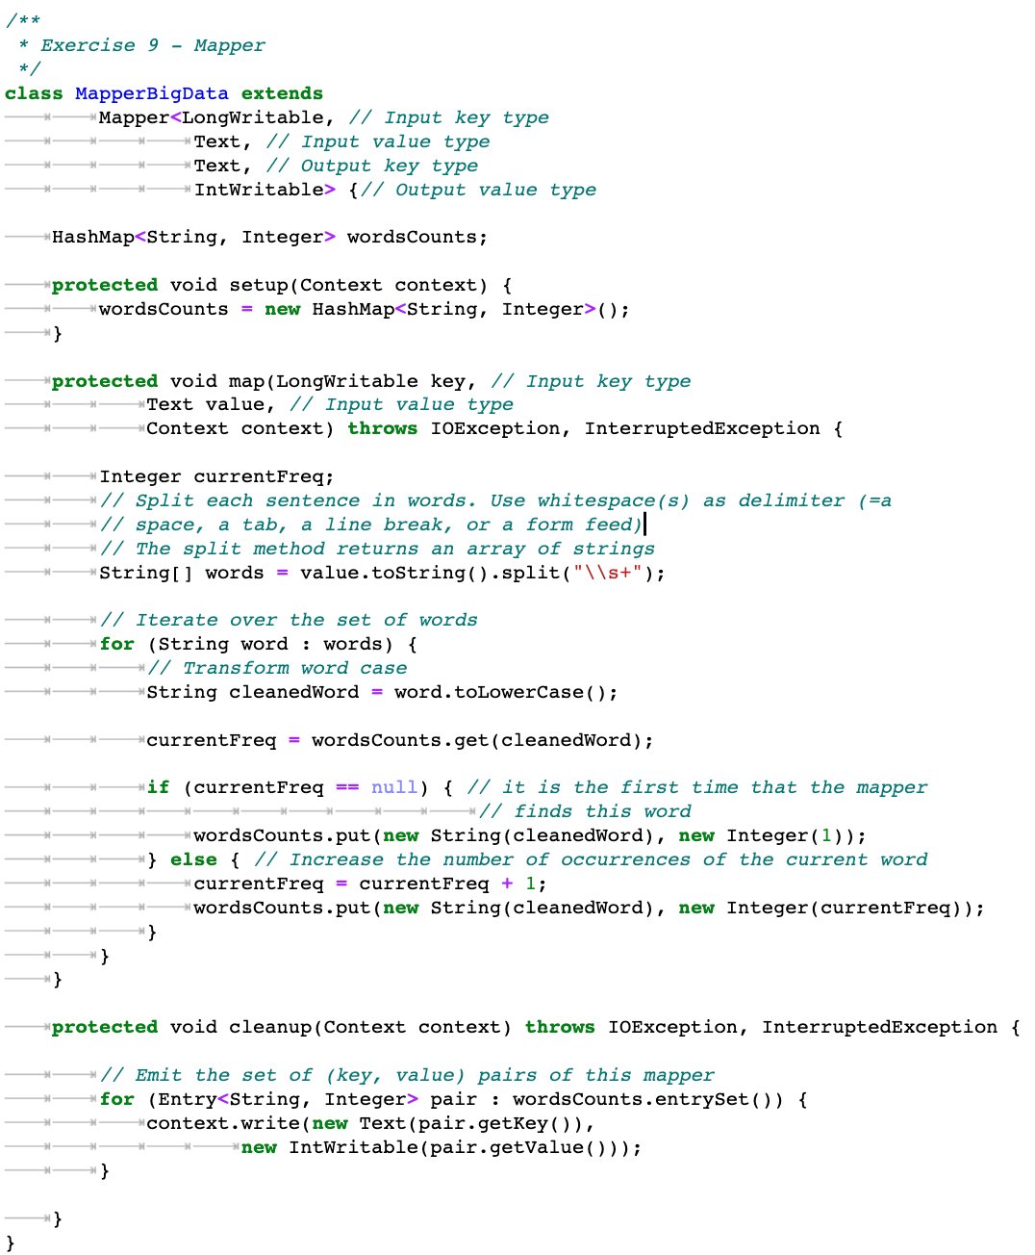



Slide 14






Slide 15



جواب دارد! حس تحلیل کردنش نبود

Slide 16






Slide 17








Slide 18




Slide 19









Slide 20








Slide 21









Slide 22




Slide 23




Slide 24






Slide 25






Slide 26




Slide 27




Slide 28



جواب دارد! حس تحلیل کردنش نبود

Slide 29







Slide 30


Slide 31






Slide 32








Slide 33










Slide 34










